Slide 1
Student Pass/Fail Prediction
P.Harshitha Reddy 2403A51181
SR University

Slide 2
Problem Statement
Many students fail due to lack of early identification
Manual tracking is difficult and time-consuming
Need a system to predict student performance in advance
Why it is important:
Helps teachers identify weak students early
Enables timely intervention and support
Improves overall academic performance

Slide 3
Project Explanation
Built a machine learning model to predict:
Pass (1) or Fail (0)
Used student-related data for prediction
Dataset includes:
Attendance
Study hours
Previous marks
Assignments
Workflow: Data Collection → Data Preprocessing → Model Training → Prediction → Results

Slide 4
Model / Algorithms Used
Logistic Regression
Decision Tree
Why these models:
Suitable for classification problems
Easy to understand and implement
Provide good accuracy on structured data

Slide 5
Performance Metrics
Accuracy – Overall correctness of model
Precision – Correct positive predictions
Recall – Ability to find all positive cases
F1-Score – Balance between precision and recall
Confusion Matrix:
True Positive, True Negative
False Positive, False Negative

Slide 6
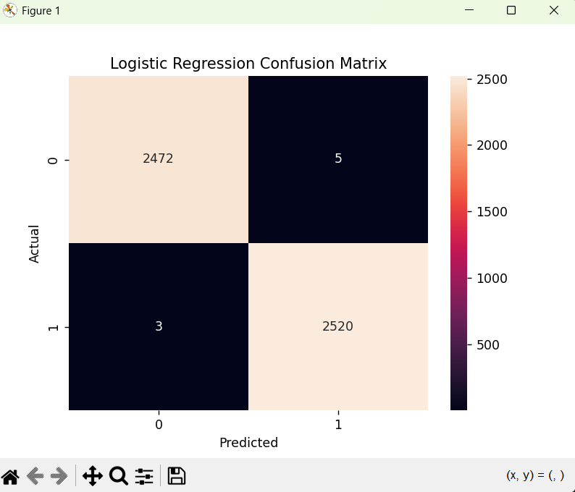
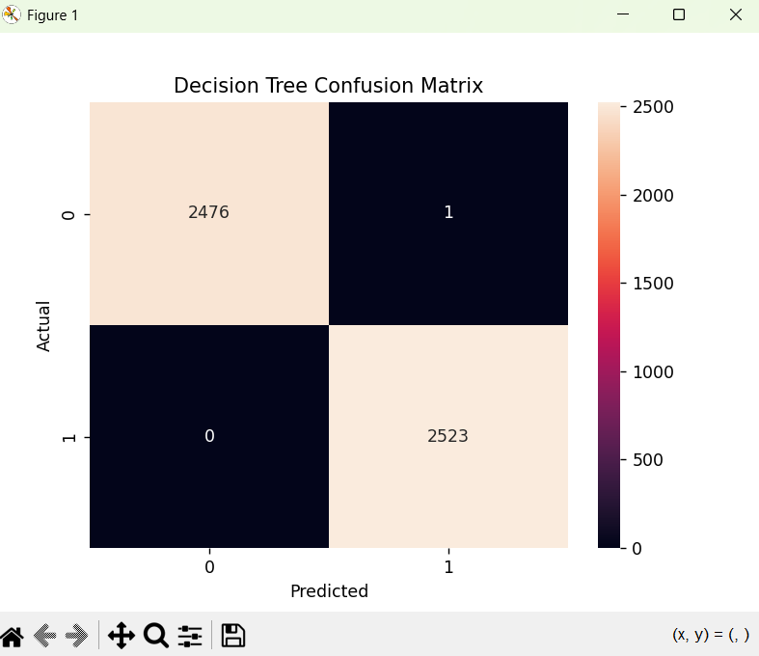
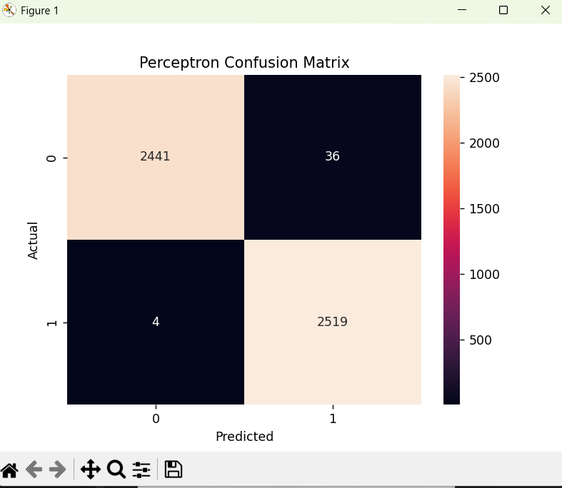
Figures/Plots

Slide 7
Outcome & Conclusion
Model successfully predicts student performance
Achieved good accuracy (mention your value)
Helps in identifying at-risk students early
What worked:
Proper data preprocessing improved accuracy
What didn’t:
Limited dataset size affects performance

Slide 8
Future improvements
Use larger and real-time datasets
Apply advanced models (Random Forest, Neural Networks)
Build a web-based prediction system
https://github.com/harshitha-reddy-06/Machine-learning/blob/main/student_prediction.py

Slide 9
Thank you

